Slide 1


VAR and VECM
Ekonometrika untuk Penelitian
Muhammad Akmal Farouqi
21/5/2024
www.ugm.ac.id
Locally Rooted, Globally Respected

Slide 2


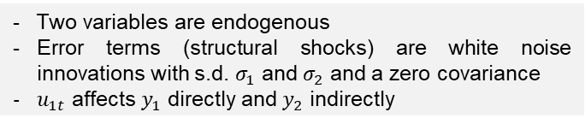
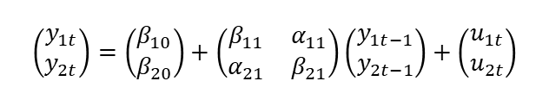
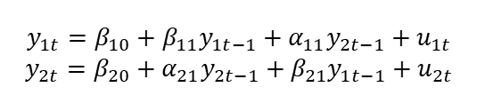
Vector Autoregressive Model (VAR)
VAR the extension of AR model that accommodates multivariate analysis. The structure is that each variable is a linear function of past lags of itself and past lags of the other variables. The main advantage of this model is the ability to perform without needing any exogeneity assumptions, especially for macroeconomics data that are prone to any endogeneity
Suppose a bivariate $Y_{t}=(y_{1},y_{2})$, the first-order VAR (or VAR(1)):
In fact, any forms of VAR can be expressed as a single equation:
$$y_{1t}=β_{10}+β_{11}y_{1t−1}+α_{11}y_{2t−1}+u_{1t}$$
$$y_{2t}=β_{20}+α_{21}y_{2t−1}+β_{21}y_{1t−1}+u_{2t}$$
$$Y_{t}=\left(\begin{matrix}y_{1t} \\ y_{2t}\end{matrix}\right), β_{t}=\left(\begin{matrix}β_{10} \\ β_{20}\end{matrix}\right), u_{t}=\left(\begin{matrix}u_{1t} \\ u_{2t}\end{matrix}\right)$$
In matrix form:
$$Y_{t}=β_{t}+βY_{t−1}+u_{t}$$
$$\left(\begin{matrix}y_{1t} \\ y_{2t}\end{matrix}\right)=\left(\begin{matrix}β_{10} \\ β_{20}\end{matrix}\right)+\left(\begin{matrix}β_{11} & α_{11} \\ α_{21} & β_{21}\end{matrix}\right)\left(\begin{matrix}y_{1t−1} \\ y_{2t−1}\end{matrix}\right)+\left(\begin{matrix}u_{1t} \\ u_{2t}\end{matrix}\right)$$
This equation explains why it is called VAR, as it describes the vectorized autoregressive equation.
Two variables are endogenous
Error terms (structural shocks) are white noise innovations with s.d. $σ_{1}$ and $σ_{2}$ and a zero covariance
$u_{1t}$ affects $y_{1}$ directly and $y_{2}$ indirectly

Slide 3
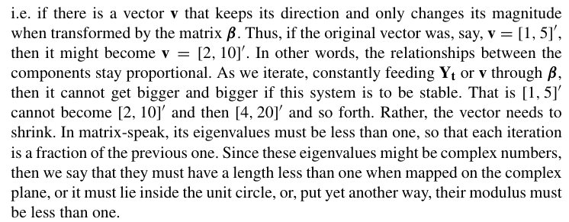
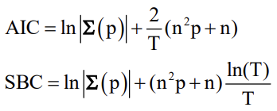
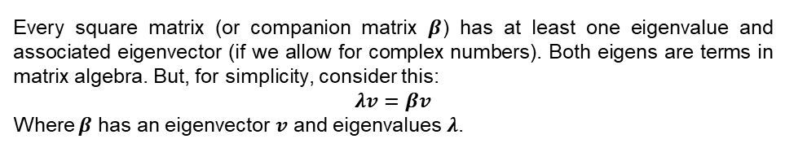
Some preparations
Determining the optimal lag length
Stationarity & Stability of the system (Time series econometrics by Lavendis)
Braun and Mittnik (1993) show that estimates of a VAR whose lag length differs from the true lag length are inconsistent
Lütkepohl (1993) indicates that overfitting causes an increase in the MSE of the VAR & underfitting generates autocorrelated errors
Every square matrix (or companion matrix $β$) has at least one eigenvalue and associated eigenvector (if we allow for complex numbers). Both eigens are terms in matrix algebra. But, for simplicity, consider this:
$$λv=βv$$
Where $β$ has an eigenvector $v$ and eigenvalues $λ$.
Most of the time, lag length specification is symmetrical across the variables. The lag length can be chosen by the Information Criteria (AIC, SIC, BIC, etc)

Slide 4
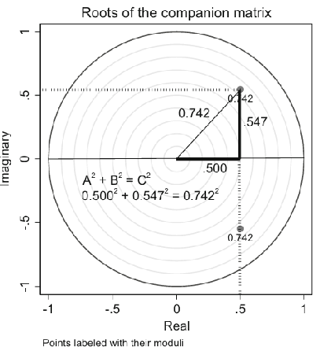
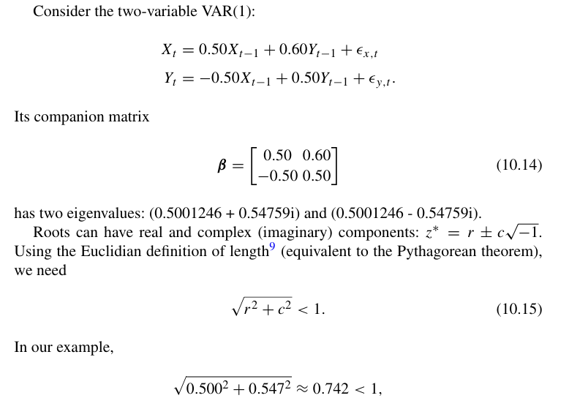
Some preparations
Stationarity & Stability of the system (Time series econometrics by Lavendis)
VAR system is “stable” if the companion matrix’s eigenvalues lie inside the unit circle (no more than 1)

Slide 5
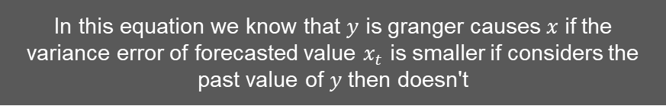
Granger Causality
Granger causality test before estimation can be useful to understand whether lagged $y_{1}$ helps explain $y_{2}$, and vice versa
statistical hypothesis test for determining whether one time series is useful in forecasting another. However, Since the question of "true causality" is deeply philosophical, and because of the post hoc ergo propter hoc fallacy of assuming that one thing preceding another can be used as a proof of causation, econometricians assert that the Granger test finds only "predictive causality”
In this equation we know that 𝑦 is granger causes 𝑥 if the variance error of forecasted value $x_{t}$ is smaller if considers the past value of 𝑦 then doesn't

Slide 6
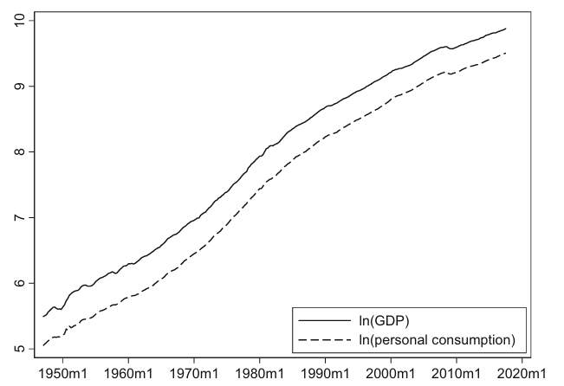
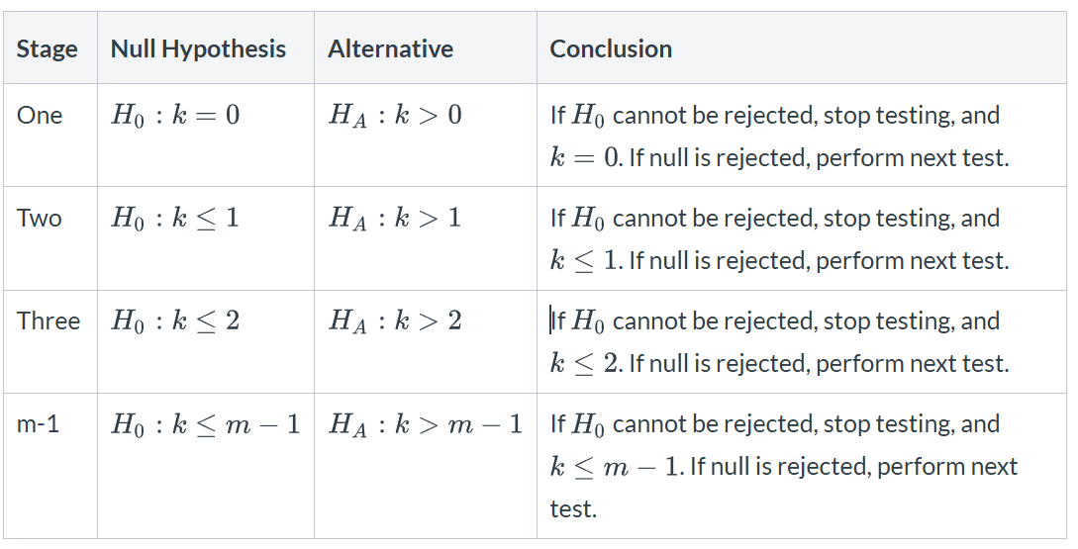
Cointegration
What if analysing non-stationary data actually yields insightful interpretation?
In econometrics, cointegration refers to a statistical relationship between two or more non-stationary time series that move together over time in such a way that a specific linear combination of them is stationary $E\left(y_{1}−y_{2}\right)=0$.
From this graph below we know that both variables are cointegrated to each other, even though both are individually non-stationary.
We can test the presence of cointegration in the system of equation using some methods, including the Johansen Cointegration test
Cointegration also can be described as a long-run equilibrium relationship between 2 or more variables

Slide 7
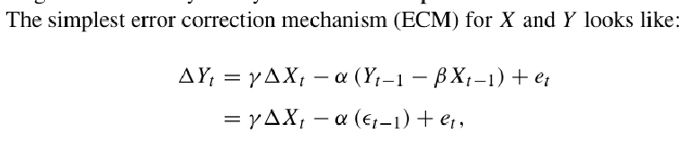

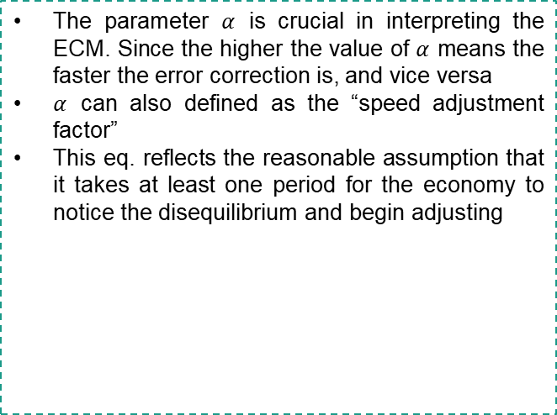
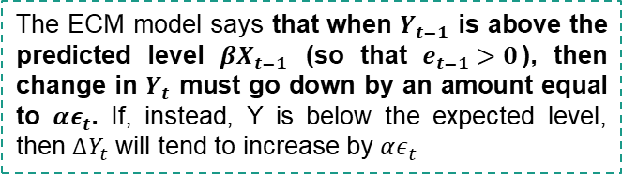
Error Correction Model
An Error Correction Model (ECM) is specifically designed to handle non-stationary data by addressing both short-term dynamics and long-term equilibrium relationships between time series variables. The term "error correction" refers to the mechanism by which deviations from the long-run equilibrium are corrected over time.
Assume a cointegrated variables $Y_{t}$ and $X_{t}$
The parameter $α$ is crucial in interpreting the ECM. Since the higher the value of $α$ means the faster the error correction is, and vice versa
$α$ can also defined as the “speed adjustment factor”
This eq. reflects the reasonable assumption that it takes at least one period for the economy to notice the disequilibrium and begin adjusting
$$Y_{t}=β_{t}+βY_{t−1}+e_{t}$$
The ECM model says that when $Y_{t−1}$ is above the predicted level $βX_{t−1}$ (so that $e_{t−1}>0$), then change in $Y_{t}$ must go down by an amount equal to $αε_{t}$. If, instead, Y is below the expected level, then $∆Y_{t}$ will tend to increase by $αε_{t}$

Slide 8







VECM
Then ECM can be extended to accommodate multi-equation models called VECM
We can derive VECM from a reduced form VAR. Suppose a reduced-form VAR model
If $Y_{t}$ is cointegrated, the VECM model is:
Where $α$ is the speed of adjustment parameters, and $β$ is an $n×r$ matrix containing coefficients of the cointegrating vectors
the adjustment parameter matrix α determines how deviations from the long-run relationship between Y and X get transferred to $∆Y_{t}$ and $∆X_{t}$.

Slide 9
Model Identification
Stationary
VAR
Transform the data
Data
Stationary Test
Partly stationary
ARDL
Cointegration does not exist
Non-stationary
Cointegration test
Cointegration exists
VECM

Slide 10
Thank You

